Slide 1

AGE 310: Instrumentation and Measurements
Lecture 12: Introduction to Agricultural Robotics
Instructor: Dr. Kadeghe Fue
Department of Agricultural Engineering
Sokoine University of Agriculture (SUA)

Slide 2


Recap & Objectives
Recap: Lecture 11
Lecture 12 Objectives
We covered Control Systems (Open vs. Closed Loop, PID Control) and how to manage actuators.
Define Agricultural Robotics vs. Mechanization.
Classify robots: Manipulators vs. Mobile.
Understand Kinematics (Forward vs. Inverse).
Analyze Coordinate Frames.
Explore applications: Harvesting, Scouting, Weeding.

Slide 3







Why Robotics in Agriculture?
Labor Shortage
Precision
24/7 Operation
Few people want to do back-breaking work like picking strawberries or weeding under the hot sun.
Robots can treat individual plants (per-plant farming) rather than treating the whole field uniformly.
Robots don't get tired, don't need lunch breaks, and can work at night (using Lidar/Thermal cameras).

Slide 4

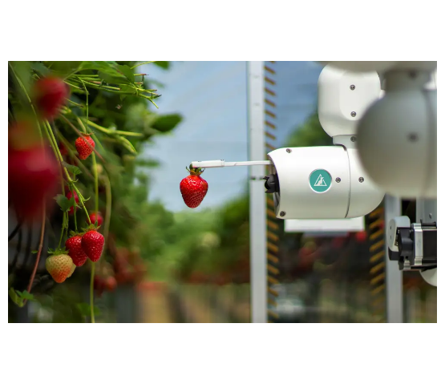
Classifying Ag Robots
1. Manipulators (Arms)
Fixed base or mounted on a vehicle. Used for picking, pruning, or precise spraying.
2. Mobile Robots
UGV (Unmanned Ground Vehicle): Autonomous tractors, weeding rovers.
UAV (Unmanned Aerial Vehicle): Drones for scouting and spraying.

Slide 5


Robot Kinematics
Kinematics is the geometry of motion. It studies the relationship between the Joint Angles and the End-Effector Position without considering forces.
Forward Kinematics
Inverse Kinematics
Given Angles → Find Position
Given Position → Find Angles

Slide 6
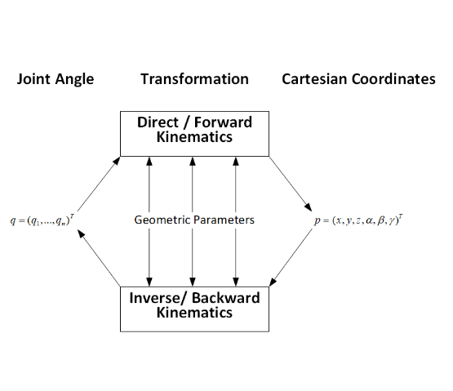
Forward Kinematics
The "Easy" Problem
If I know the angle of my shoulder ( ) and my elbow ( ), where is my hand?
Input: Joint parameters (angles/extensions).
Output: Cartesian coordinates (X, Y, Z) of the tool.
Used for monitoring and visualization.

Slide 7
Inverse Kinematics (IK)
The "Hard" Problem
Challenges
I want to move my hand to the apple at (X, Y, Z). What angles must my joints take?
Multiple Solutions: There are many ways to touch your nose (elbow up, elbow down).
Input: Target Position.
Singularities: Positions where the robot gets "stuck" or requires infinite speed.
Output: Required Joint Angles ( ).
Essential for path planning.

Slide 8
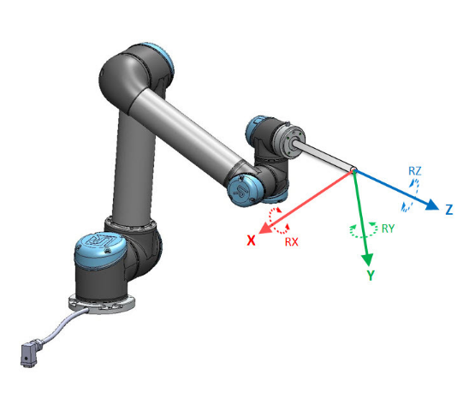
Coordinate Frames
A robot must understand multiple "worlds":
Base Frame {B}: Fixed to the robot's base (0,0,0).
Tool Frame {T}: Attached to the gripper tip (TCP - Tool Center Point).
World Frame {W}: Fixed to the ground/field (GPS coordinates).
Goal: Transform the Apple's location from the {Camera Frame} to the {Base Frame} so the arm can move.

Slide 9


End Effectors (The "Hand")
The device at the end of the arm that interacts with the crop.
Vacuum Grippers: Suction cups for delicate fruits (Apples, Tomatoes).
[Soft Gripper Image]
Soft Grippers: Silicon fingers that wrap around irregular shapes.
Cutters: Scissors or saws for pruning.
Sprayers: Micro-nozzles for spot weeding.

Slide 10
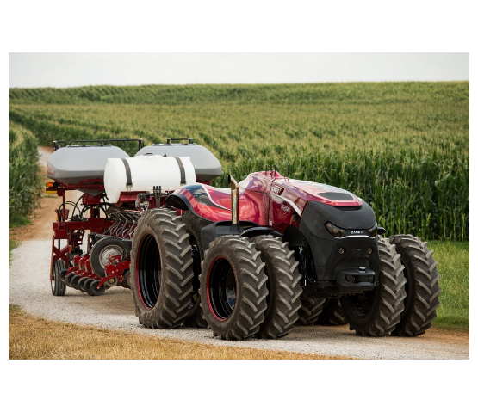
Mobile Robotics: Autonomous Tractors
Navigation Tech
How does a tractor drive itself?
RTK-GNSS: GPS with 2cm accuracy.
IMU: Inertial Measurement Unit (Compass/Gyro) for tilt compensation.
Lidar/Radar: Obstacle detection (Safety).
Machine Vision: Following crop rows (Camera).

Slide 11
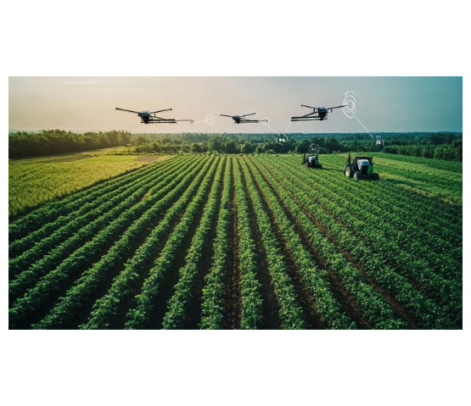
Aerial Robotics: Agricultural Drones
Applications
Scouting: Multispectral cameras measure NDVI (Plant Health).
Spraying: Precise application of pesticides on difficult terrain (e.g., rice paddies, hills).
Mapping: Creating 3D Digital Elevation Models (DEM) for drainage planning.

Slide 12
Challenges in Ag Robotics
The Environment
The Object (Crop)
Unlike a factory, a farm is unstructured.
Biological variability.
Lighting changes (Clouds/Sun).
Every apple is a different size/location.
Terrain is uneven and muddy.
Leaves occlude (hide) the fruit.
Wind affects drones and spray.
Fruits are delicate and bruise easily.

Slide 13





Case Study: Visual Servoing
Visual Servoing is using camera feedback to control the robot's motion in real-time.
1. Detection
2. Tracking
3. Grasping
Camera identifies the red apple against green leaves (Machine Learning).
As the arm moves, the camera keeps the apple centered in the frame.
Sonar/Lidar measures distance. Hand closes when .

Slide 14
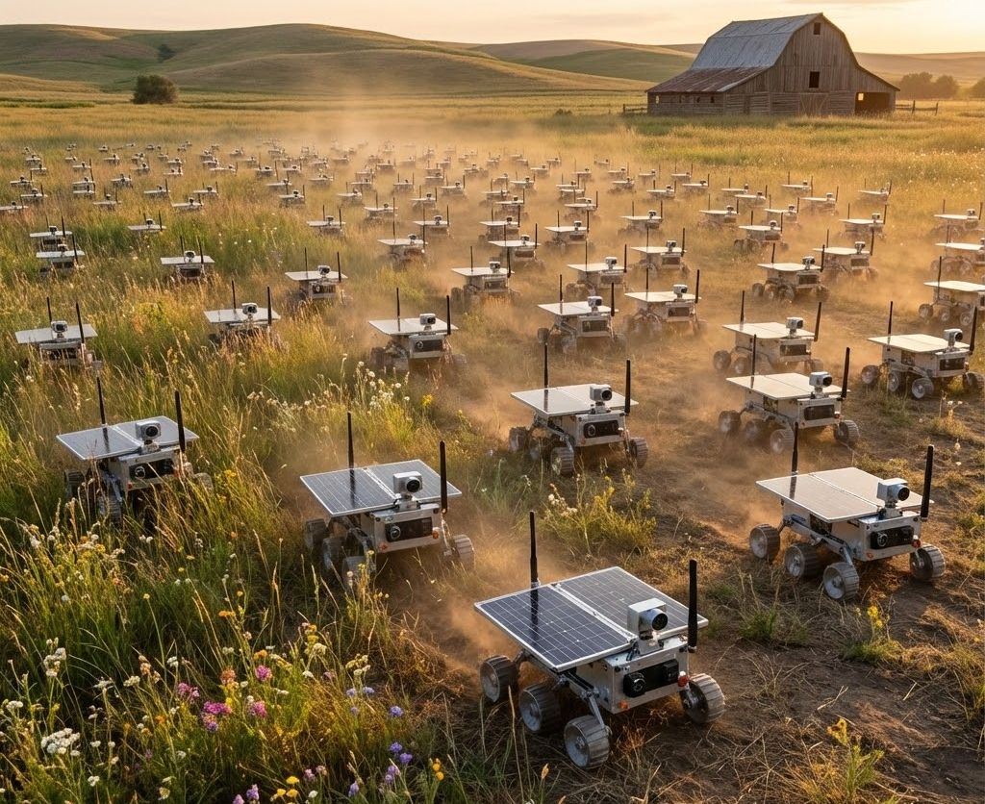
Future Trends: Swarm Robotics
Instead of one massive, heavy tractor (which compacts soil), use many small robots.
Redundancy: If one robot breaks, the rest continue.
Scalability: Buy more robots as the farm grows.
Soil Health: Light weight prevents compaction.

Slide 15

Discussion & Questions
End of Lecture 12
Assignment: Research "Degrees of Freedom" (DOF). How many DOF does a human arm have? How many does a typical Spraying Drone have?
Dr. Kadeghe Fue | AGE 310 | SUA

